Slide 1
Resource Constrained Programming
Andreas Danner Nilsen andreas.nilsen@arm.com

Slide 2

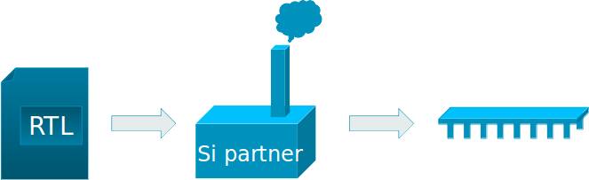
ARM
A CPU Company 230 billion chips sold
Mali GPU created in Trondheim ~200 employees in Trondheim
Notes:
SI partner: system integrator partner

Slide 3
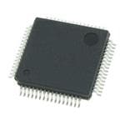
What is an Microcontroller (MCU)?
It’s a small computer... - CPU - RAM - Program storage (may be read-only) - Peripherals (ports, clocks, DAC / ADC, GPIO, other stuff) ...all on a single chip. Main differences to a PC: Performance, heat, power usage, transistor count, cost pluggability, peripherals
ATSAMS70J20B-AN Can be yours for 65 NOK

Slide 4
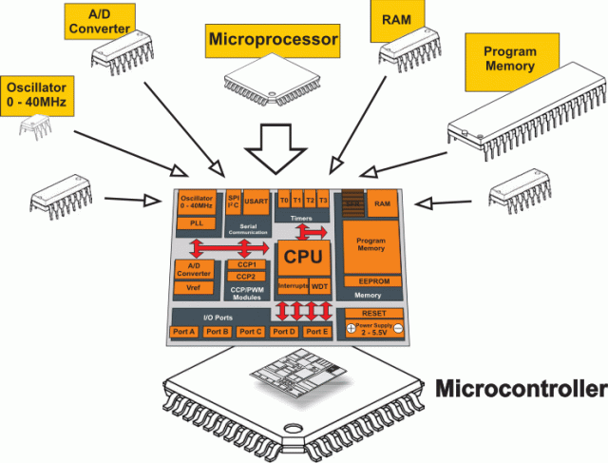

Slide 5
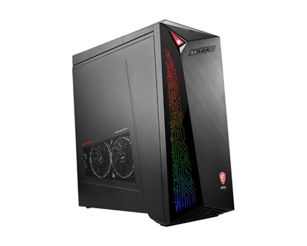
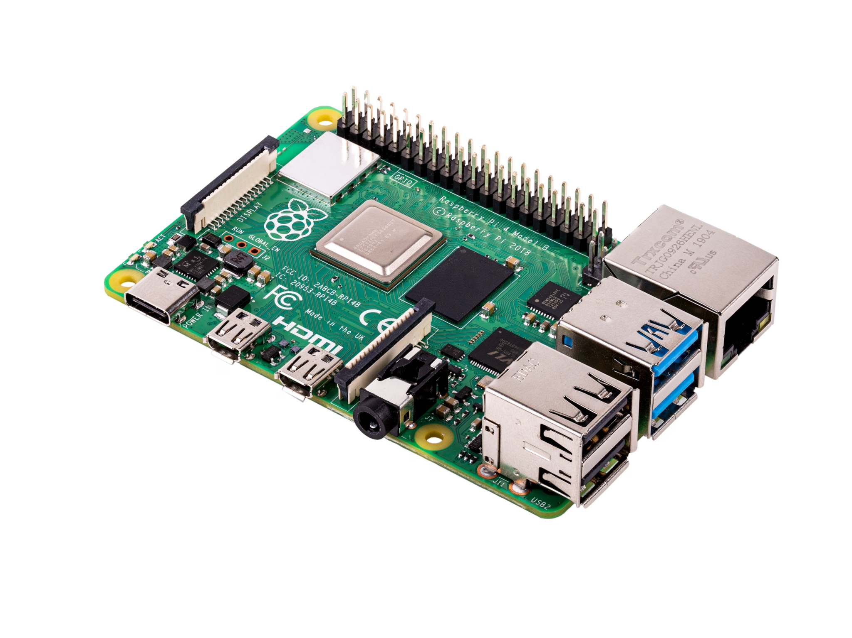
PC vs MCU
Raspberry Pi 4, MCU
A state of the ART PC

Slide 6
PC vs MCU
PC CPU: AMD Ryzen 5950X, 4.9 GHz, 16 cores RAM: 64 Gb Storage: 2 TB, SSD Power Usage: ~1000 W
MCU CPU: ARM Cortex A72 @ 1.5 GHz, 1 core RAM: 1 GB Storage: MicroSD slot Power Usage: 15W

Slide 7
PC vs MCU
PC CPU: AMD Ryzen 5950X, 4.9 GHz, 16 cores RAM: 64 Gb Storage: 2 TB, SSD Power Usage: ~1000 W
MCU CPU: ARM Cortex A72 @ 1.5 GHz, 1 core RAM: 1 GB Storage: MicroSD slot Power Usage: 15W
Apollo Moon Landing Computer CPU: Custom Made @ 2 MHz RAM: 2048 16-bit words Storage: 36864 16-bit words, ROM Power Usage: 55 W Comparable to a 1970’s home computer

Slide 8
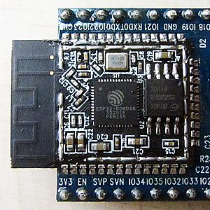
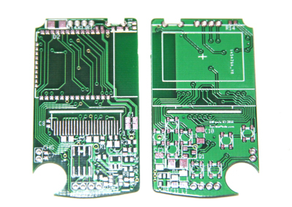
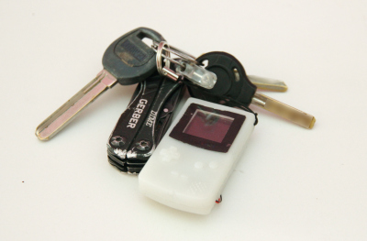
Small is awesome!

Slide 9
Programming for Microcontrollers
MCUs have constraints.
Limits on Memory
Limits on Performance
Limits on Code Size (storage)
Limits on support libraries
Limits on OS functionality - there may be none!
Limits on Power
You must write programs with those constraints in mind.

Slide 10
Performance Constraints
Algorithmic space-time tradeoff: Use more CPU time and less memory Use less CPU time and more memory Embedded CPUs are weak - but not bad Avoid doing unnecessary work Most gains are still on the algorithmic level Brush up on TDT4120 - Algoritmer og datastrukturer
The small stuff Optimize for performance, not size? Compiler flag -O3 Every function call adds overhead. Consider inlining / static functions / macros / LTO Reduce Load/Store operations where possible Optimizing randomly is meaningless. Use a profiler to identify hotspots!

Slide 11
Power Constraints
P_{cpu} = P_{dyn} + P_{sc} + P_{leak}
If your MCU spends most of its time sleep()’ing Transistor leakage is the main power eater
Your circuit is mostly acting as a resistance
What HW can be turned off when you sleep?
What is the cost of waking up?
Maximize sleep time
One wakeup better than many small ones
CPU Power scaling per MHz is linear (ca)
Keep frequency high
If your MCU spends most of its time working Transistor toggling the main power eater
Can we reduce the CPU frequency?
Can we reduce the CPU Voltage?
Some ops are more expensive (multiply, load)
Reduce workloads
Frequency gridlocked with Voltage
CPU Power scaling per V is cubic (ca)
Clocking down is better than sleeping
Reduce workload to allow CPU to do that
P_{dyn} = CV²f ≈ Cf³
Notes:
Pdynamic is the cost of transitioning a gate from on to off, or vice versa. It is zero for most of the time in the left example, and the only factor of interest in the right example. Pshort_circuit is the power loss due to short-circuits while transitioning. Often baked into Pdynamic. It is hard to model Pleak is the power the power use that happens when gates are on HW on. Or off. Goes to zero if you [partially] turn off the chip.

Slide 12
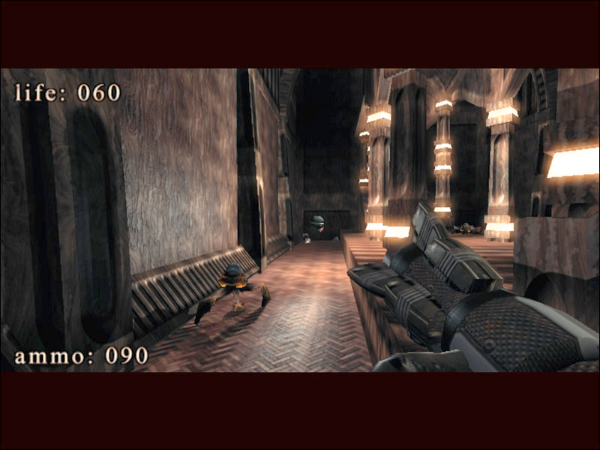
Storage Constraints
Limits binary + data + libraries Optimize code for size: -Os Strip your binaries Compression possible, if needed Program with these limits in mind Store your data efficiently Generate your data, don’t load them? Abuse what libraries you have available Remove libraries you can do without
.kkrieger, playable win32 game, 97 280 bytes

Slide 13
Embedded OS
Embedded System OS’es are written with the same constraints.
Usually no threads, one process (OS drivers are just interrupt handlers)
Limited OS functionality (f.ex, no memory protection, swapdisk, limited # mutexes, other modern conveniences)
And they add to the storage size, ram limits
Do you even need an Embedded OS? Run Bare metal?

Slide 14
Memory Constraints (RAM)
Algorithmic space-time tradeoff: Use more CPU time and less memory Use less CPU time and more memory Mostly about how you store your data in RAM Code is either in RAM or ROM. If RAM: Smaller code size → less memory footprint Keep track of what your compiler puts into your code automatically → strings Stack cost memory. → Avoid recursion.
Use minimal datatypes, clever / simpler datastructures

Slide 15
Structure Packing and Alignments
struct foo { unsigned char a; // 1 byte int b[2]; // 2*4 bytes double c; // 8 bytes unsigned char d; // 1 byte };
How big is this structure in RAM? ^{(assuming 32bit datatypes)}

Slide 16
Structure Packing and Alignments
struct foo { unsigned char a; // 1 byte int b[2]; // 2*4 bytes double c; // 8 bytes unsigned char d; // 1 byte };
Total size in ram: 32 bytes
Type alignment:
CPU load/store have alignment limitations
Each datatype is aligned to its own size
For stack, compiler will rearrange variables to optimize mem use
For structures… it can’t.
Struct members aligned to size
Structures aligned to the worst member → in case of arrays
offset 3..0 |  |  |  | a
offset 7..4 | b0 | b0 | b0 | b0
offset 11..8 | b1 | b1 | b1 | b1
offset 15..12
offset 19..16 | c | c | c | c
offset 23..20 | c | c | c | c
offset 27..24 |  |  |  | d
offset 31..28

Slide 17
Structure Packing and Alignments
struct foo { double c; // 8 bytes int b[2]; // 2*4 bytes unsigned char a; // 1 byte unsigned char d; // 1 byte };
Total size in ram: 24 bytes
Type alignment:
CPU load/store have alignment limitations
Each datatype is aligned to its own size
For stack, compiler will rearrange variables to optimize mem use
For structures… it can’t.
Struct members aligned to size
Structures aligned to the worst member → in case of arrays
offset 3..0 | c | c | c | c
offset 7..4 | c | c | c | c
offset 11..8 | b0 | b0 | b0 | b0
offset 15..12 | b1 | b1 | b1 | b1
offset 19..16 |  |  | d | a
offset 23..20

Slide 18
Structure Packing and Alignments
struct foo { unsigned char a; // 1 byte int b[2]; // 2*4 bytes double c; // 8 bytes unsigned char d; // 1 byte } __attribute__((packed));
Total size in ram: 18 bytes
Packed structures are SLOW!
CPU can’t load members directly ASM must unpack them by reading bytes → lots of extra load/stores, instructions.
offset 3..0 | b0 | b0 | b0 | a
offset 7..4 | b1 | b1 | b1 | b0
offset 11..8 | c | c | c | b1
offset 15..12 | c | c | c | c
offset 19..16 |  |  | d | c

Slide 19
Bitmasks
How to work with bits

Slide 20
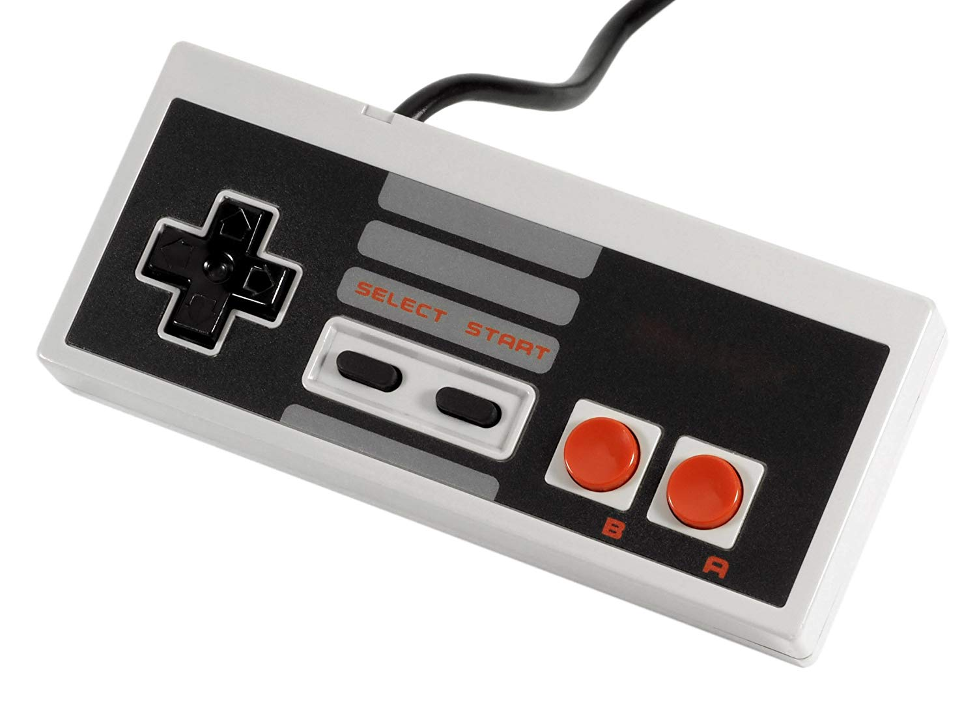
How to create 8 booleans
I want to track the state of each of my 8 buttons. How would you do this in C/C++?

Slide 21
Straightforward approach
bool joypad[8]; // press right button joypad[3] = true;
This is the straightforward approach. Nothing wrong with this.
But what happens under the hood here?
Index | Pressed?
0 (UP) | FALSE
1 (DOWN) | FALSE
2 (LEFT) | FALSE
3 (RIGHT) | TRUE
4 (A) | TRUE
5 (B) | TRUE
6 (SELECT) | FALSE
7 (START) | FALSE

Slide 22
Straightforward approach: Under the hood
bool joypad[8];
bool is just a typedef’d unsigned char. The following is equivalent code:
unsigned char joypad[8];
Each cell holds 1 byte (8 bits) of data. Very easy/fast to access each state using 8-bit LOAD/STORE instructions. But: Wasting RAM. (Modern programming: who cares?)
Index | Bitwise Offset | Value
0 (UP) | 0 | 0x00
1 (DOWN) | 8 | 0x00
2 (LEFT) | 16 | 0x00
3 (RIGHT) | 24 | 0x01
4 (A) | 32 | 0x01
5 (B) | 40 | 0x01
6 (SELECT) | 48 | 0x00
7 (START) | 56 | 0x00

Slide 23
Bitmasks
An int is just a sequence of bits (usually 32) Why not consider it an array? (we only need 8 entries for the gamepad example) Problem: There is no* array addressing for bits … but we can make some!
Bit Offset
31 | ... | 13 | 12 | 11 | 10 | 9 | 8
7 | 6 | 5 | 4 | 3 | 2 | 1 | 0
Value
unused, leave as 0
0 | 0 | 0 | 1 | 1 | 1 | 0 | 0

Slide 24
Bitwise operators
AND operator: & OR operator: | XOR operator: ^ NOT operator: ~ These offer bitwise addressing … kinda.

Slide 25
Setting bits in a bitmask
To set explicit bits in a variable in C, use the bitwise or operator: |
int var = 17; var = var | 130; printf("%d\n", var); // 147
value 17
0 | 0 | 0 | 1 | 0 | 0 | 0 | 1
value 130
1 | 0 | 0 | 0 | 0 | 0 | 1 | 0
1 | 0 | 0 | 1 | 0 | 0 | 1 | 1

Slide 26
Setting bits in a bitmask
This example is much more readable using hexadecimal values
int var = 0x11; var = var | 0x82; printf("%x\n", var); // 0x93 printf("%d\n", var); // 147
0 | 0 | 0 | 1 | 0 | 0 | 0 | 1
1 | 0 | 0 | 0 | 0 | 0 | 1 | 0
1 | 0 | 0 | 1 | 0 | 0 | 1 | 1

Slide 27
Setting bits in a bitmask
The or-assign operator is also easier to write → get used to this form.
int var = 0x11; var |= 0x82; printf("%x\n", var); // 0x93 printf("%d\n", var); // 147
0 | 0 | 0 | 1 | 0 | 0 | 0 | 1
1 | 0 | 0 | 0 | 0 | 0 | 1 | 0
1 | 0 | 0 | 1 | 0 | 0 | 1 | 1

Slide 28
Timeout: This is still not readable enough
int joypad = 0x11; joypad |= 0x82;
Casual readers won’t know what’s going on. Readability is super important when doing low-level code.

Slide 29
Making it more readable
int joypad = KEY_UP|KEY_A; // press some more buttons var |= KEY_START|KEY_DOWN;
Very common pattern when working with HW.
#define KEY_UP (1<<0) #define KEY_DOWN (1<<1) #define KEY_LEFT (1<<2) #define KEY_RIGHT (1<<3) #define KEY_A (1<<4) #define KEY_B (1<<5) #define KEY_SELECT (1<<6) #define KEY_START (1<<7)
1 | 0 | 0 | 1 | 0 | 0 | 1 | 1

Slide 30
Negating a value
To bitwise negate a value, use the ~ operator. Pretty straightforward… int var = KEY_UP|KEY_DOWN; int negated = ~var; printf("%x\n", negated); // 0xFFFFFFFC
#define KEY_UP (1<<0) #define KEY_DOWN (1<<1)
value 0x3
0 | ... | 0 | 0 | 0 | 0 | 0 | 0
0 | 0 | 0 | 0 | 0 | 0 | 1 | 1
value ~0x3
1 | ... | 1 | 1 | 1 | 1 | 1 | 1
1 | 1 | 1 | 1 | 1 | 1 | 0 | 0

Slide 31
Clearing Bits
To clear bits in a variable in C, use bitwise & operator with the negated clear bits int var = KEY_UP|KEY_DOWN; var = var & ~KEY_UP; printf("%x\n", var); // 0x02
#define KEY_UP (1<<0) #define KEY_DOWN (1<<1)
value 0x3
0 | ... | 0 | 0 | 0 | 0 | 0 | 0
0 | 0 | 0 | 0 | 0 | 0 | 1 | 1
value ~0x1
1 | ... | 1 | 1 | 1 | 1 | 1 | 1
1 | 1 | 1 | 1 | 1 | 1 | 1 | 0
result &
0 | ... | 0 | 0 | 0 | 0 | 0 | 0
0 | 0 | 0 | 0 | 0 | 0 | 1 | 0

Slide 32
Clearing Bits
Again, the AND-assign operator is easier to write → get used to this form too! int var = KEY_UP|KEY_DOWN; var &= ~KEY_UP; printf("%x\n", var); // 0x02
#define KEY_UP (1<<0) #define KEY_DOWN (1<<1)

Slide 33
Toggling Bits
XOR flips a bit to the opposite state. The operator is ^ int var = KEY_UP | KEY_DOWN; var ^= KEY_UP; printf("%x\n", var); // 0x2 var ^= KEY_UP; printf("%x\n", var); // 0x3
#define KEY_UP (1<<0) #define KEY_DOWN (1<<1)

Slide 34
In summary
To set a bit: var |= KEY_UP; To clear a bit: var &= ~KEY_UP; To toggle a bit: var ^= KEY_UP;

Slide 35
Check if a bit is set
int joypad; // bitmask ... if ( joypad & KEY_DOWN ) { // do stuff }
All values not 0 are true in C/C++ (and ASM CMP instructions). Generally: do not check if(value == true) - this adds overhead Instead: check if(value)
#define KEY_UP (1<<0) #define KEY_DOWN (1<<1)

Slide 36
Iterating over bits
How do we do the equivalent of bool joypad[8]; ... int num_pressed = 0; for (int i = 0; i < 8; i++) { if(joypad[i]) { num_pressed++; } }
using bitmasks?

Slide 37
Iterating over bits
bool joypad[8]; ... int num_pressed = 0; for (int i = 0; i < 8; i++) { if(joypad[i]) { num_pressed++; } }
int joypad; // bitmask ... int num_pressed = 0; for (int i = 0; i < 8; i++) { int candidate = (1<<i); if(joypad & candidate) { num_pressed++; } }

Slide 38
Iterating over bits
But… We can do even better!
int joypad; // bitmask ... int num_pressed = 0; for (int i = 0; i < 8; i++) { int candidate = (1<<i); if(joypad & candidate) { num_pressed++; } }

Slide 39
Iterating over bits
int joypad; // bitmask ... int num_pressed = 0; int i = joypad; // copy do { if(i & 1) { num_pressed++; } i = i >> 1; } while(i);
int joypad; // bitmask ... int num_pressed = 0; for (int i = 0; i < 8; i++) { int candidate = (1<<i); if(joypad & candidate) { num_pressed++; } }
Even better: Your CPU may have an ASM instruction to do this (POPCNT)...
Notes:
See: POPCNT instruction for an asm instruction doing just this op in If not available on your architecture; a lookup table with 256 entries may also be a good deal (trading instruction count for memory traffic) - if this really matter. Premature optimization is the root of all evil. We need a way to truly tell what is the best deal.

Slide 40
Going Assembly
Let’s look at that even closer

Slide 41
Let’s look at assembly level (ARM thumb)
Array version first. bool joypad[8]; ... int num_pressed = 0; for (int i = 0; i < 8; i++) { if(joypad[i]) { num_pressed++; } }
mov r3, #0 ; i = 0 mov r0, r3 ; num_pressed = 0 ldr r1, <joypad> ; address, joypad loop: ldrb r2, [r3, r1] ; load joypad[i] add r3, r3, #1 ; i++ subs r4, r2, #1 ; sbcs r2, r2, r4 ; r2 → { 0 or 1 } add r0, r0, r2 ; num_pressed += r2 cmp r3, #8 ; i < 8? bne <loop> ; → do another loop

Slide 42
Let’s look at assembly level
Summary:
10 instructions stored
59 instructions executed
9 memory loads executed
Weird logic with subs/sbcs needed to convert r2 to boolean. → Convert int to bit
mov r3, #0 ; i = 0 mov r0, r3 ; num_pressed = 0 ldr r1, <joypad> ; address, joypad loop: ldrb r2, [r3, r1] ; load joypad[i] add r3, r3, #1 ; i++ subs r4, r2, #1 ; sbcs r2, r2, r4 ; r2 → { 0 or 1 } add r0, r0, r2 ; num_pressed += r2 cmp r3, #8 ; i < 8? bne <loop> ; → do another loop

Slide 43
Compare that to the bitmask version
int joypad; // bitmask ... int num_pressed = 0; int i = joypad; // copy do { if(i & 1) { num_pressed++; } i = i >> 1; } while(i);
mov r0, #0 ; num_pressed = 0 mov r1, #1 ; register holding value 1 ldr r3, <joypad> ; i = joypad loop: mov r2, r3 ; and r2, r1 ; r2 = i & 1 add r0, r0, r2 ; num_pressed += r2 asr r3, r3, #1 ; i = i >> 1 bne <loop> ; if i != 0 → loop

Slide 44
Compare that to the bitmask version
Summary:
8 instructions stored
8-43 instructions executed
1 memory load executed
No mem access in the inner loop → super fast!
mov r0, #0 ; num_pressed = 0 mov r1, #1 ; register holding value 1 ldr r3, <joypad> ; i = joypad loop: mov r2, r3 ; and r2, r1 ; r2 = i & 1 add r0, r0, r2 ; num_pressed += r2 asr r3, r3, #1 ; i = i >> 1 bne <loop> ; if i != 0 → loop

Slide 45
Optimizing for Assembly
Play around with it yourself https://www.godbolt.org/ or your local compiler Results differ per compiler/settings Configure your compiler for your CPU architecture

Slide 46
Talking to HW
From the CPU

Slide 47
System Bus
$
CPU
Memory
IO
Display Controller
Sound Controller
0 | 12
1 | 41
2 | 125
3 | 5729
...
0xFFFF | 52
0 | 1
1 | 0
..
0xFF | 1
0 | 0
1 | 0
2 | 0
...
480 | 0
0 | 1
1 | 4800

Slide 48
Memory Mapped I/O
Each platform has a memory map
HW units only react to bus traffic on “their” address range
To modify any HW state, just to a STR.
To read any HW outputs, just do a LD.
Reading/writing memory mapped addresses…
Simply activates the HW - as designed
What happens is up to the HW
Example 16bit platform mapping
Address range | Size | Device
0000–7FFF | 32 KiB | RAM
8000–80FF | 256 bytes | General-purpose I/O
9000–90FF | 256 bytes | Sound controller
A000–A7FF | 2 KiB | Video controller (text)
C000–FFFF | 16 KiB | ROM (Program)
Advanced HW operations, like DMA / GPIO usually are exposed through libraries.

Slide 49
Memory Mapped I/O - Example
volatile unsigned char * const screen = (unsigned char* const) 0xA000; screen[0] = 'W'; screen[1] = 'h'; screen[2] = 'e'; screen[3] = 'e'; // could I use memcpy?
const volatile unsigned int * const joypad = 0x803B; if ( *joypad & KEY_UP) { … }
Example 16bit platform mapping
Address range | Size | Device
0000–7FFF | 32 KiB | RAM
8000–80FF | 256 bytes | General-purpose I/O
9000–90FF | 256 bytes | Sound controller
A000–A7FF | 2 KiB | Video controller (text)
C000–FFFF | 16 KiB | ROM (Program)
Read C types right to left
Notes:
Memcpy issues that really make its use scary
Memcpy may read/write in any specific order.
The call may be replaced with inline code by the compiler. Multiple consecutive writes may disappear.
The memcpy call casts away the volatile flag!
IO memory accesses often require a certain word-size (ie, HW requires you to write four bytes, but memcpy may write an integer).

Slide 50
Memory Mapped I/O - Example
volatile unsigned char * const screen = (unsigned char* const) 0xA000; screen[0] = 'W'; screen[1] = 'h'; screen[2] = 'e'; screen[3] = 'e'; // could I use memcpy?
const volatile unsigned int * const joypad = 0x803B; if ( *joypad & KEY_UP) { … }
Example 16bit platform mapping
Address range | Size | Device
0000–7FFF | 32 KiB | RAM
8000–80FF | 256 bytes | General-purpose I/O
9000–90FF | 256 bytes | Sound controller
A000–A7FF | 2 KiB | Video controller (text)
C000–FFFF | 16 KiB | ROM (Program)
Read C types right to left void *memcpy(void *dest, const void * src, size_t n)
Notes:
Memcpy issues that really make its use scary
Memcpy may read/write in any specific order.
The call may be replaced with inline code by the compiler. Multiple consecutive writes may disappear.
The memcpy call casts away the volatile flag!
IO memory accesses often require a certain word-size (ie, HW requires you to write four bytes, but memcpy may write an integer).

Slide 51
volatile pitfalls
Compiler volatile guarantees:
Won’t reorder volatile operations
Won’t optimize away volatile operations
NO guarantees on:
Atomicity → don’t use for thread safety
Ordering vs non-volatile operations (function calls, data dependencies exempt)
CPU caches removing transactions entirely (use uncached/device memory mappings!)
Order of completion of operations (Use strongly ordered memory mappings!? → slow) (alternatively, see next slide!)
// PC speaker example, local var volatile int * const spkr = 0x9000; *spkr = SOUND_A9; sleep(1000); *spkr = SOUND_OFF;
No volatile → no sound.

Slide 52
Barriers
Instructions do not execute in order
CPU Optimizations allow parallel execution
System Bus reorders transactions
Caches impact when things complete
To ensure completion, you need a barrier
CPU instructions (ARM examples) DMB - block future memory ops DSB - block future instructions
Linux provides C functions as per right side
Barriers are expensive!
barrier() - compiler barrier Code above issued before code below Not an instruction, just a compiler directive. Volatile gives you this as well mb() - memory barrier memory operations above complete before operations below are issued rmb() - read memory barrier As above, reads only wmb() - write memory barrier As above, writes only
Notes:
DMB - data memory barrier
DSB - Data Synchronization barrier

Slide 53
Thinking in C

Slide 54
Scenario: Phone display orientation
There are four ways (states) to orient a phone display.
12:08
12:08
12:08
12:08
Portrait
Upside Down
Landscape Left
Landscape Right

Slide 55
Scenario: Phone display orientation
Your phone sees that feature like this
12:08
12:08
12:08
12:08
Portrait
Upside Down
Landscape Left
Landscape Right

Slide 56
Scenario: Phone display orientation
I would like a function that tells me → where is the new origin (red dot) in portrait coords? → what are the dimensions in transformed coords?
function input: - 1920x1080 - “Landscape Right” function output: - origin: <0,1079> - dimensions: <1080,1920>
12:08
Strings suck…
Landscape Right

Slide 57
Enum is the simple answer
It’s the obvious way to do it… … but it has a problem: code duplication.
enum orientation { PORTRAIT, UPSIDE_DOWN, LANDSCAPE_LEFT, LANDSCAPE_RIGHT };

Slide 58
Enum function example
void get_rotation_info( enum orientation orientation, int in_w, int in_h, struct info *out) { switch(orientation) { case ENUM_PORTRAIT: out->transformed_w = in_w; out->transformed_h = in_h; out->transformed_origin_x = 0; out->transformed_origin_y = 0; break; case ENUM_UPSIDE_DOWN: out->transformed_w = in_w; out->transformed_h = in_h; out->transformed_origin_x = in_w-1; out->transformed_origin_y = in_h-1; break;
case ENUM_LANDSCAPE_LEFT: out->transformed_w = in_h; out->transformed_h = in_w; out->transformed_origin_x = in_w-1; out->transformed_origin_y = 0; break; case ENUM_LANDSCAPE_RIGHT: out->transformed_w = in_h; out->transformed_h = in_w; out->transformed_origin_x = 0; out->transformed_origin_y = in_h-1; break; } }
Portrait
Upside Down
Landscape Left
Landscape Right
Notes:
You can easiliy see this has code duplication, but you may not be able to tell why…

Slide 59
Enum function example
void get_rotation_info( enum orientation orientation, int in_w, int in_h, struct info *out) { switch(orientation) { case ENUM_PORTRAIT: out->transformed_w = in_w; out->transformed_h = in_h; out->transformed_origin_x = 0; out->transformed_origin_y = 0; break; case ENUM_UPSIDE_DOWN: out->transformed_w = in_w; out->transformed_h = in_h; out->transformed_origin_x = in_w-1; out->transformed_origin_y = in_h-1; break;
case ENUM_LANDSCAPE_LEFT: out->transformed_w = in_h; out->transformed_h = in_w; out->transformed_origin_x = in_w-1; out->transformed_origin_y = 0; break; case ENUM_LANDSCAPE_RIGHT: out->transformed_w = in_h; out->transformed_h = in_w; out->transformed_origin_x = 0; out->transformed_origin_y = in_h-1; break; } }
Portrait
Upside Down
Landscape Left
Landscape Right

Slide 60
Enum function example
void get_rotation_info( enum orientation orientation, int in_w, int in_h, struct info *out) { switch(orientation) { case ENUM_PORTRAIT: out->transformed_w = in_w; out->transformed_h = in_h; out->transformed_origin_x = 0; out->transformed_origin_y = 0; break; case ENUM_UPSIDE_DOWN: out->transformed_w = in_w; out->transformed_h = in_h; out->transformed_origin_x = in_w-1; out->transformed_origin_y = in_h-1; break;
case ENUM_LANDSCAPE_LEFT: out->transformed_w = in_h; out->transformed_h = in_w; out->transformed_origin_x = in_w-1; out->transformed_origin_y = 0; break; case ENUM_LANDSCAPE_RIGHT: out->transformed_w = in_h; out->transformed_h = in_w; out->transformed_origin_x = 0; out->transformed_origin_y = in_h-1; break; } }
Portrait
Upside Down
Landscape Left
Landscape Right

Slide 61
Enum function example
void get_rotation_info( enum orientation orientation, int in_w, int in_h, struct info *out) { switch(orientation) { case ENUM_PORTRAIT: out->transformed_w = in_w; out->transformed_h = in_h; out->transformed_origin_x = 0; out->transformed_origin_y = 0; break; case ENUM_UPSIDE_DOWN: out->transformed_w = in_w; out->transformed_h = in_h; out->transformed_origin_x = in_w-1; out->transformed_origin_y = in_h-1; break;
case ENUM_LANDSCAPE_LEFT: out->transformed_w = in_h; out->transformed_h = in_w; out->transformed_origin_x = in_w-1; out->transformed_origin_y = 0; break; case ENUM_LANDSCAPE_RIGHT: out->transformed_w = in_h; out->transformed_h = in_w; out->transformed_origin_x = 0; out->transformed_origin_y = in_h-1; break; } }
Portrait
Upside Down
Landscape Left
Landscape Right

Slide 62
Same function, optimized
void get_rotation_info( int orientation, // bitmask int in_w, int in_h, struct info *out) { if( orientation == ENUM_PORTRAIT || orientation == ENUM_UPSIDE_DOWN) { out->transformed_w = in_w; out->transformed_h = in_h; } else { out->transformed_w = in_h; out->transformed_h = in_w; }
Portrait
Upside Down
Landscape Left
Landscape Right
if( orientation == ENUM_UPSIDE_DOWN || orientation == ENUM_LANDSCAPE_LEFT) { out->transformed_origin_x = in_w-1; } else { out->transformed_origin_x = 0; }
if( orientation == ENUM_UPSIDE_DOWN || orientation == ENUM_LANDSCAPE_RIGHT) { out->transformed_origin_y = in_h-1; } else { out->transformed_origin_y = 0; } }
Notes:
Much smaller code. Not at all as readable, but…

Slide 63
Thinking in C bitmasks
Orientations actually define operations
Flip Origin to other edge in the X axis
Flip Origin to other edge in the Y axis
Swap X/Y dimensions
We can build some bitmask enums with this in mind
Portrait
Upside Down
Landscape Left
Landscape Right

Slide 64
Thinking in C bitmasks
Orientations actually define operations
Flip Origin to other edge in the X axis
Flip Origin to other edge in the Y axis
Swap X/Y dimensions
These new #defines replace the enum. They also define how to do the transform
Portrait
Upside Down
Landscape Left
Landscape Right
#define BIT_FLIP_X (1 << 0) #define BIT_FLIP_Y (1 << 1) #define BIT_SWAP_XY (1 << 2)
#define PORTRAIT ( 0 ) #define UPSIDE_DOWN ( BIT_FLIP_X | BIT_FLIP_Y ) #define LANDSCAPE_LEFT ( BIT_FLIP_X | BIT_SWAP_XY ) #define LANDSCAPE_RIGHT ( BIT_FLIP_Y | BIT_SWAP_XY )

Slide 65
Same function, with bitmasks
void get_rotation_info( int orientation, // bitmask int in_w, int in_h, struct info *out) { if( orientation & BIT_SWAP_XY ) { out->transformed_w = in_w; out->transformed_h = in_h; } else { out->transformed_w = in_h; out->transformed_h = in_w; } if( orientation & BIT_FLIP_X ) { out->transformed_origin_x = in_w-1; } else { out->transformed_origin_x = 0; }
Portrait
Upside Down
Landscape Left
Landscape Right
if( orientation & BIT_FLIP_Y ) { out->transformed_origin_y = in_h-1; } else { out->transformed_origin_y = 0; } }

Slide 66
Comparing Assembly (x86)
Switch + Enum version:
31 instructions whereof 9 will be run at any given input
4 branches
If + Enum version:
19 instructions, whereof all will be run
0 branches
Bitmask version:
13 instructions whereof all will be run
0 branches
Which is best?

